Slide 1


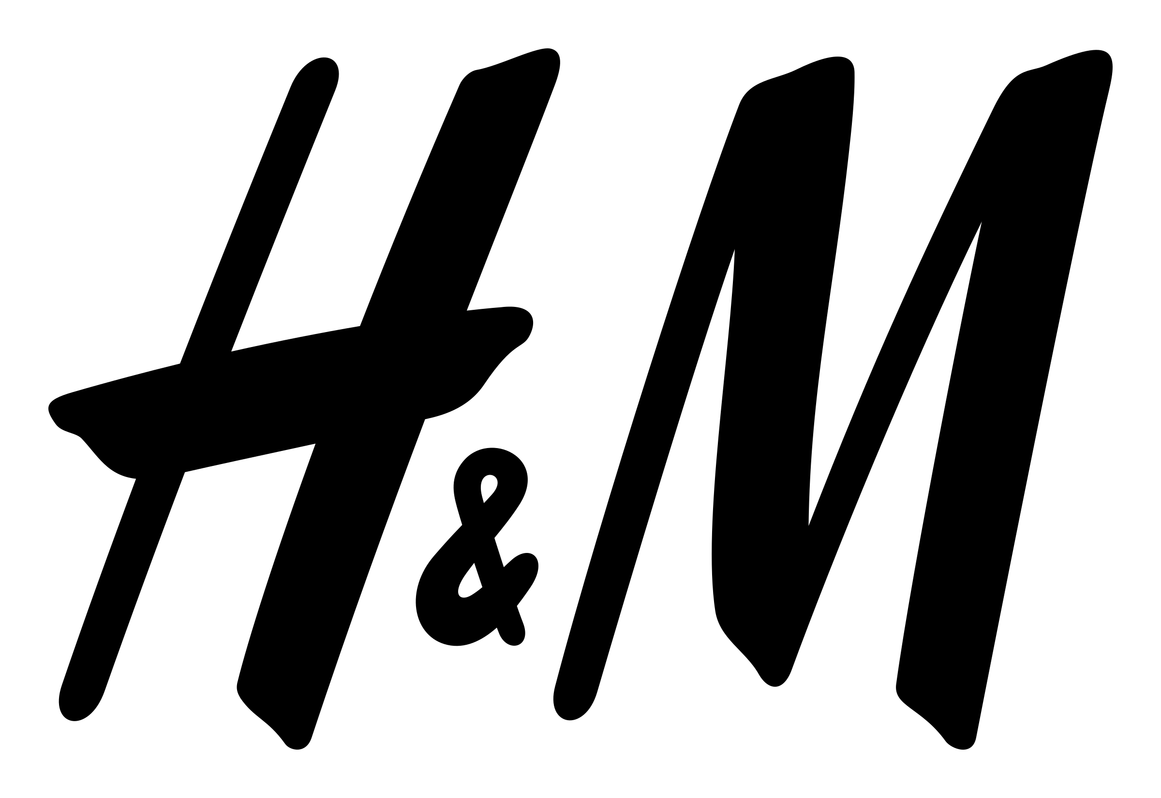
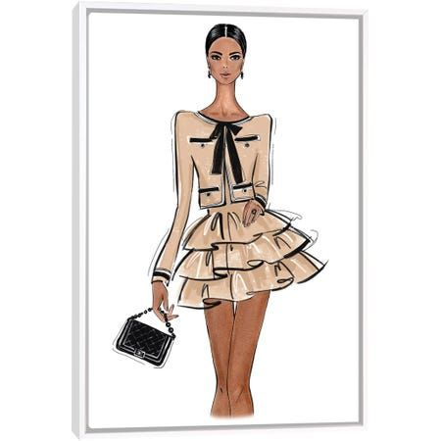
Fashion Recommender System for H&M
Using
Natural Language Processing
Parisa Rahmani

Slide 2

Introduction
H&M (Hennes & Mauritz) is one of the world’s largest fashion retailers
Founded in Sweden in 1947, H&M operates in over 75 countries with more than 4,000 stores worldwide, along with a strong online presence. It is a globally recognized brand, particularly popular among younger shoppers seeking fast fashion options.

Slide 3
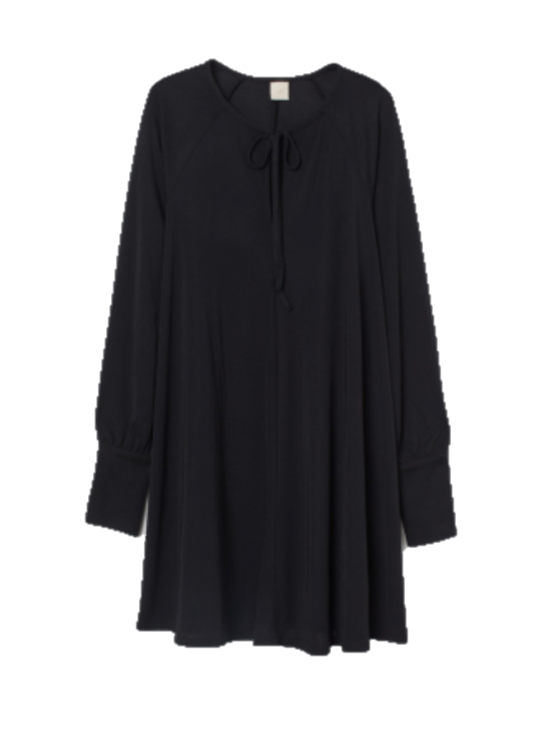
Problem Statement Improving the Online Shopping Experience with Smart Fashion Recommendations
Description:
Short, A-line dress in jersey with a round neckline and V-shaped opening at the front with narrow ties. Long, voluminous raglan sleeves and wide cuffs with covered buttons.

Slide 4
Hypothesis
We believed that product descriptions contain rich enough information to recommend items that are stylistically similar — even without using images or manual tags
Product Description
Text processing
Similarity Model
Top N Similar Items

Slide 5

Data Set Overview
1.
Articles DF
2.
Transactions DF
3.
Customers
DF
Shape:
(105542, 25)
Shape:
(31788324, 5)
Shape:
(1371980, 7)

Slide 6
Data Cleaning
Removed punctuation, numbers
Removed missing descriptions.
Converted all text to lowercase
Removed common filler words like “the” or “and”
Simplified words to their root form (e.g., “running” became “run”)

Slide 7
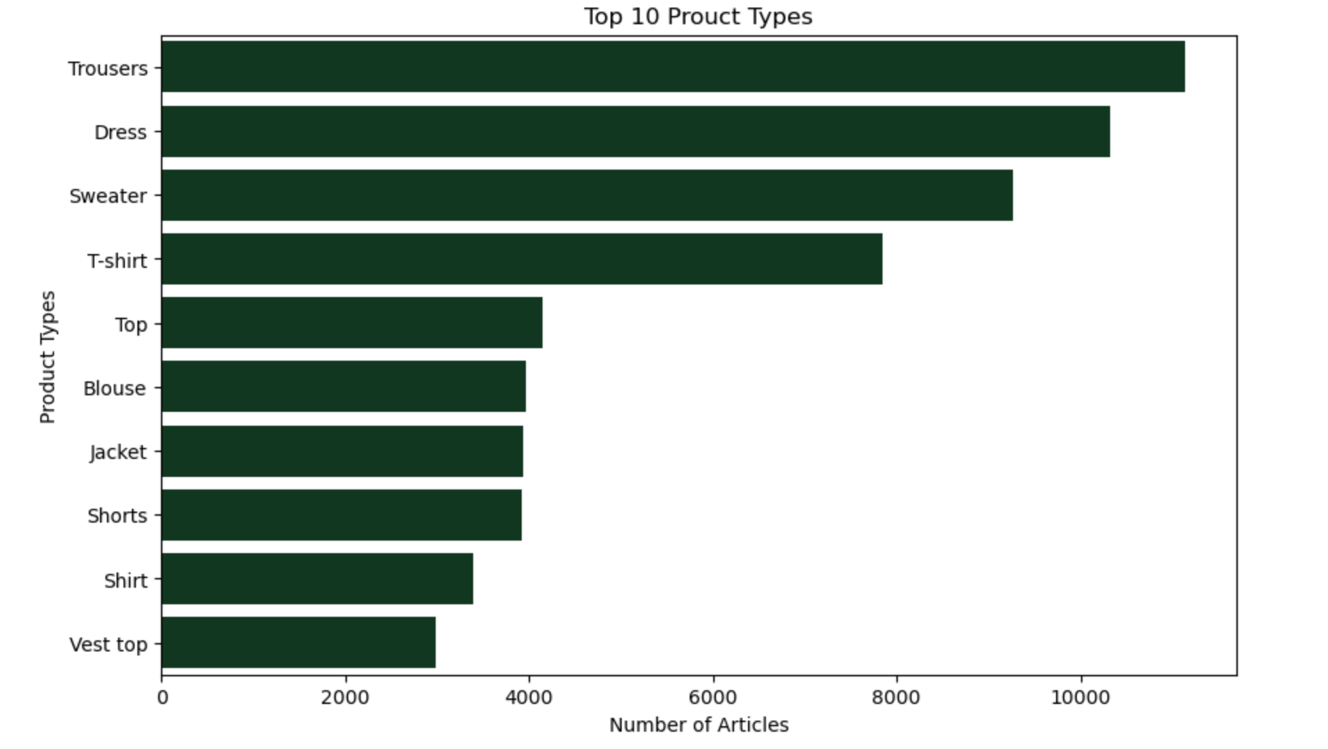
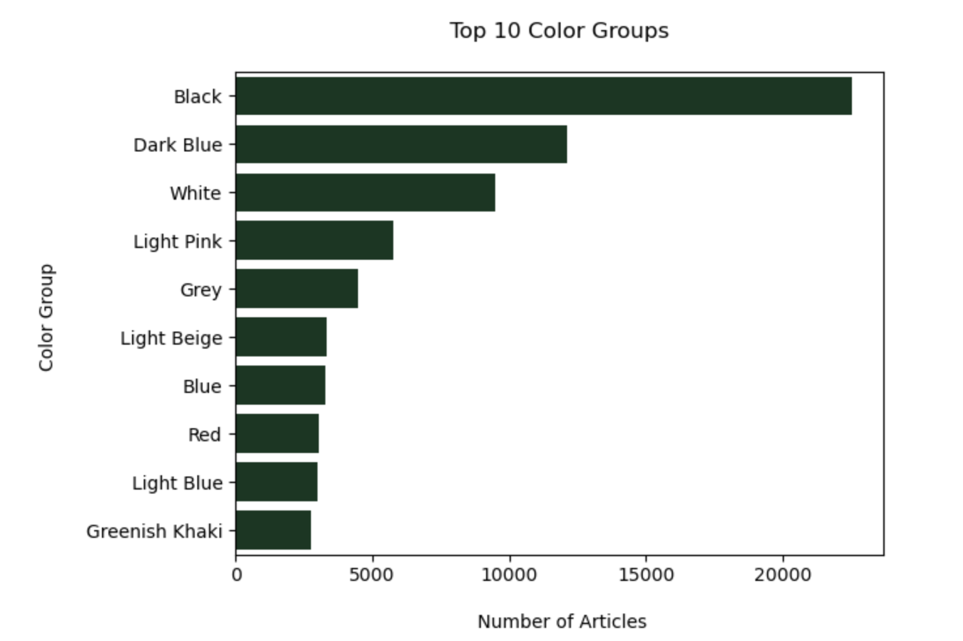
Exploratory Data Analysis
Before modeling, we explored the text data to better understand common fashion patterns.

Slide 8
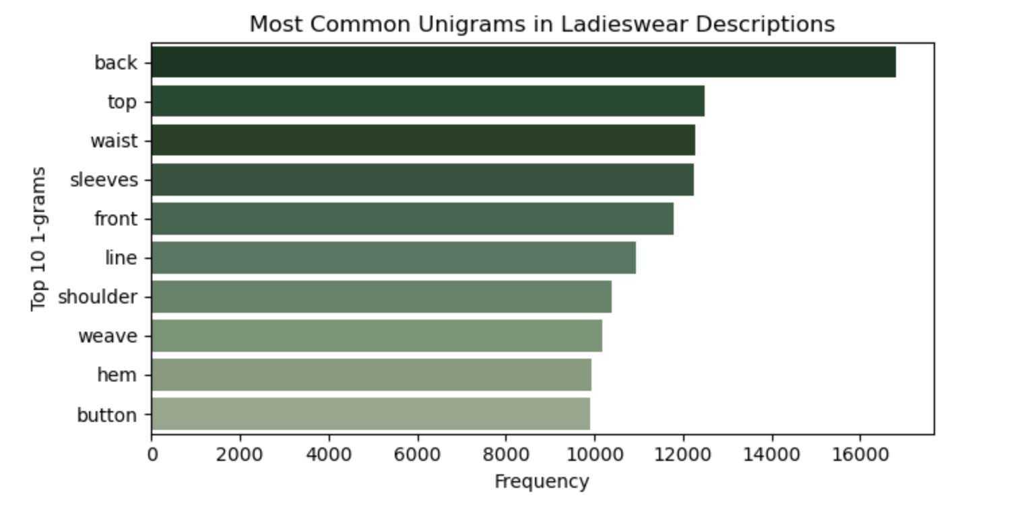
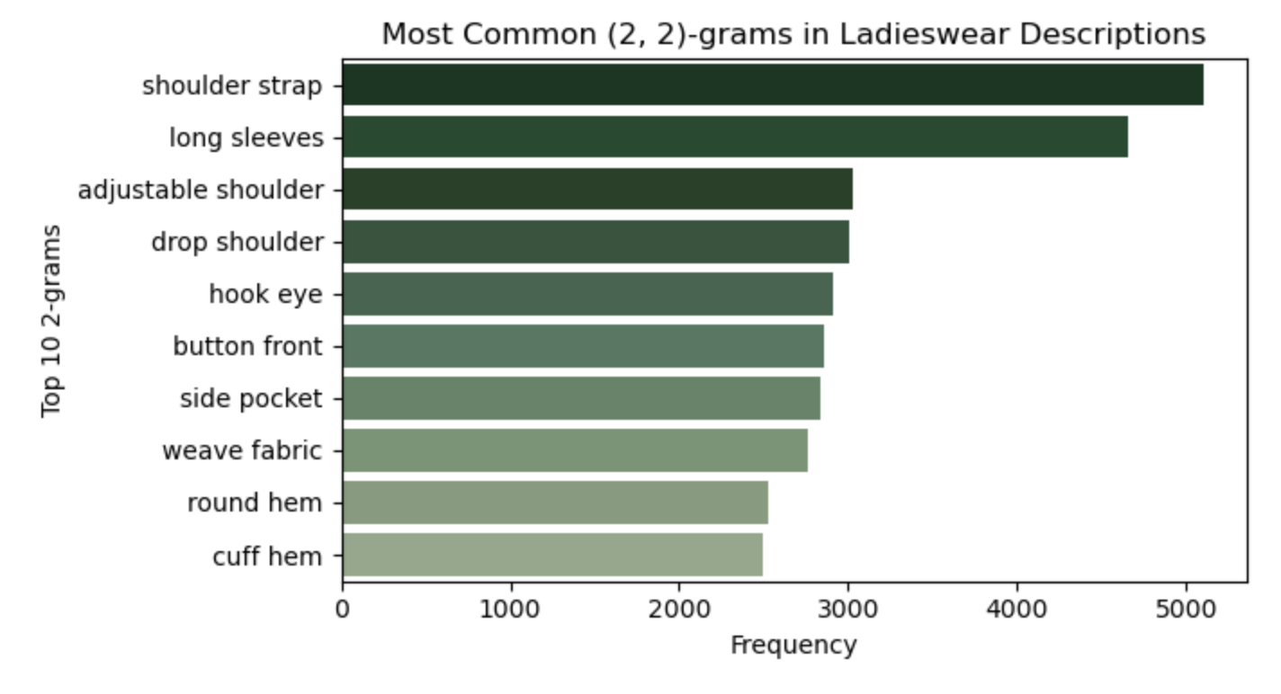
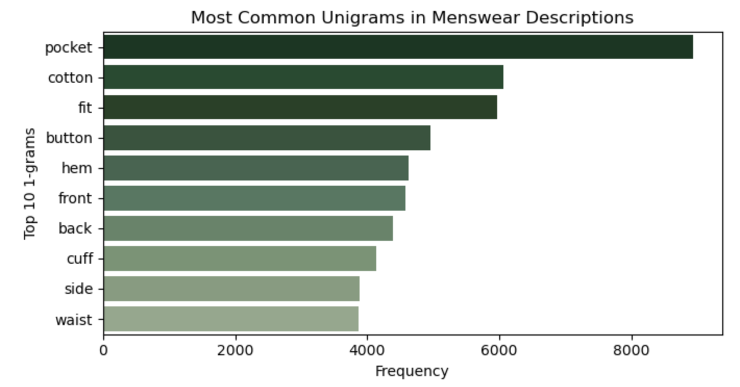
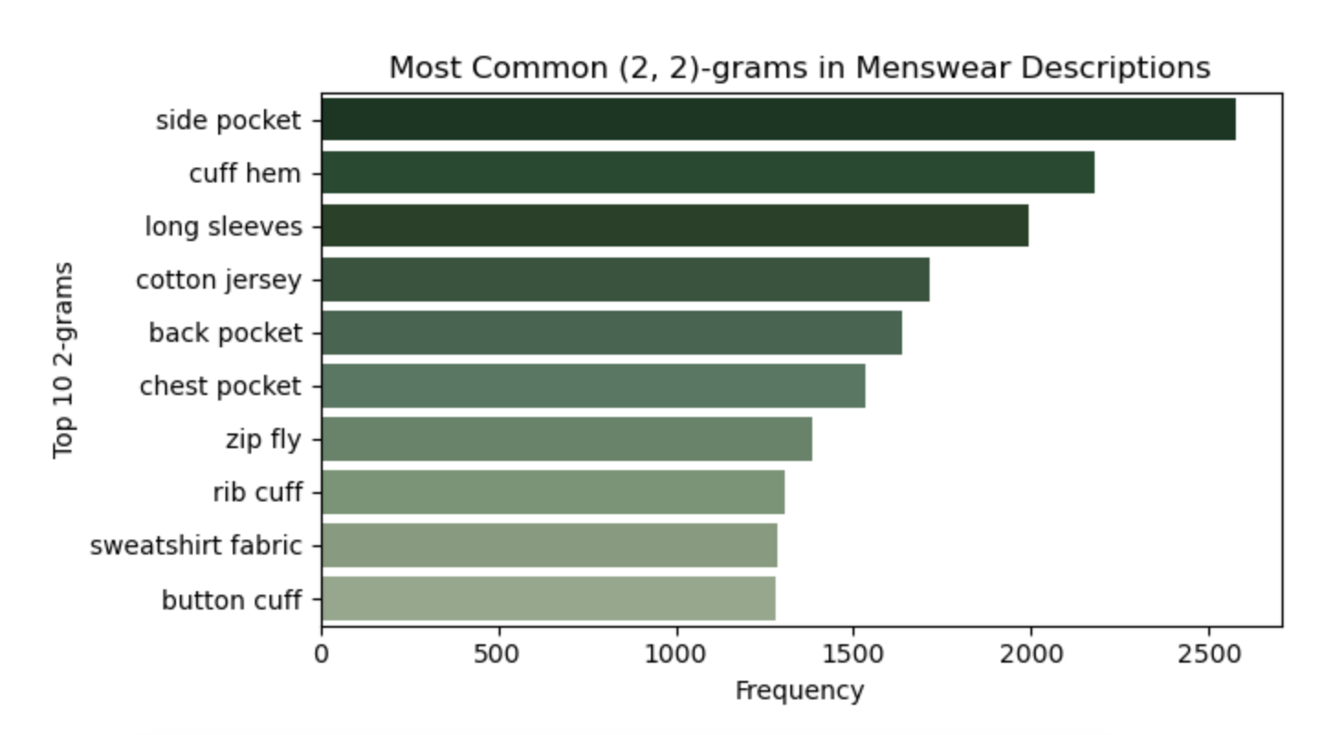

Slide 9
Two Modeling Methods
Focuses on important words in each item’s description.
Ex: Cotton blouse → Looks for “cotton”
TF-IDF
A more advanced model that understands the context and meaning of sentences.
Ex: Cotton blouse → Knows it’s summerwear
Bert

Slide 10
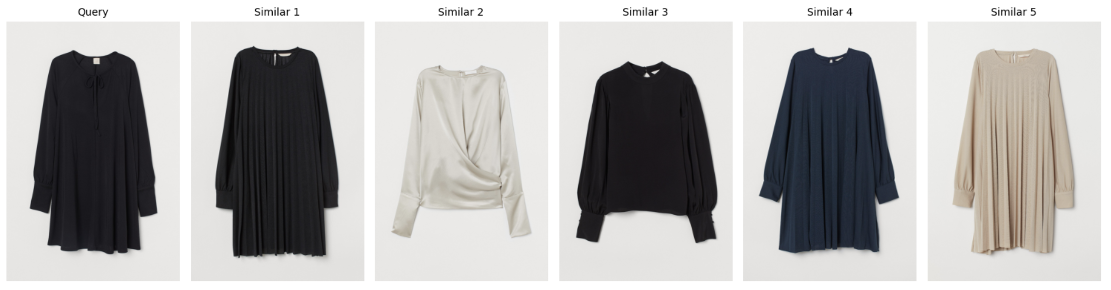
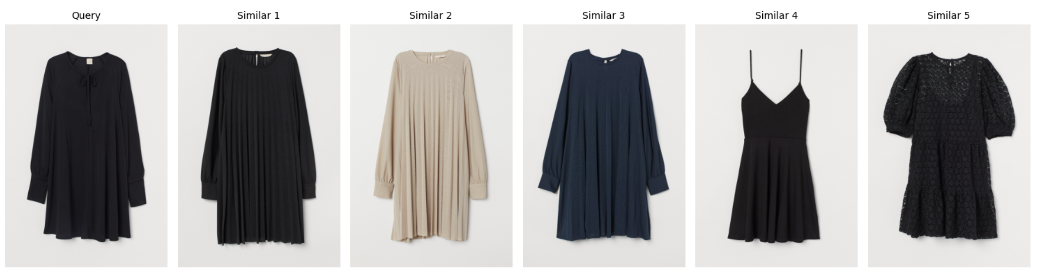
Top 5 Similar Items
TF-IDF
Bert

Slide 11


Recommendation Based on Customers History
We used BERT and looked at purchase history to personalize recommendations.
Then, for a sample customer, we found:
Items they bought in the past
Similar fashion items they might like next

Slide 12
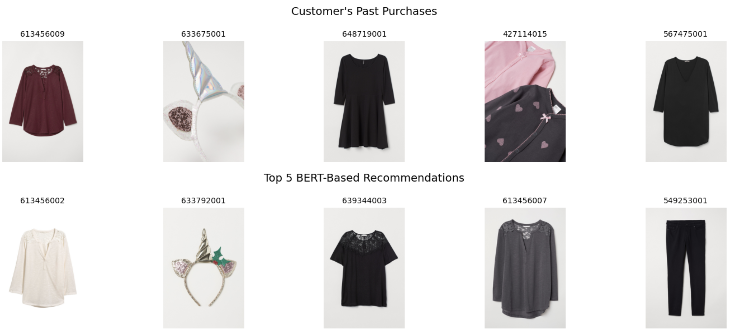
Recommendation Based on Customers History

Slide 13
Key Insights
1.
BERT provided more accurate and relevant recommendations
2.
Recommendations can be enhanced even further by using customer purchase history
3.
Fashion descriptions alone carry a lot of hidden patterns

Slide 14
Future Ideas
1.
Learn from Other Customers Behaviour
2.
Build a small demo app to test live recommendations

Slide 15



Thank you!

